Slide 1


eagle–i
March 2011
OBI workshop
San Diego, CA
www.eagle-i.org/home
c o n s o r t i u m

Slide 2
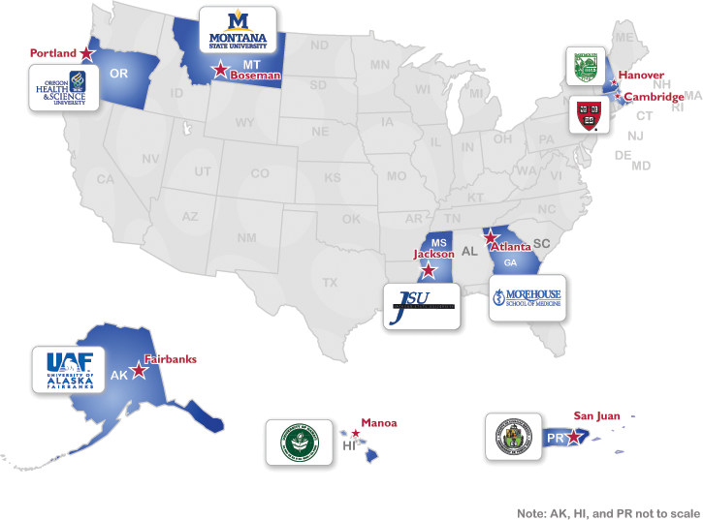
eagle-i
NIH funded 2-year pilot project working to make scientific research resources more visible via a federated network of nine institutional repositories
Helping researchers find invisible
resources
reagents, protocols, techniques, instruments, expertise, organisms, software, training, human studies, biological specimens, etc.
Adding meaningful semantic relationships between resources
Making this data available using ontology-driven approach to research resource annotation and discovery
Reducing time-consuming and expensive duplication of resources
www.eagle-i/home
c o n s o r t i u m

Slide 3
eagle-i challenges
Build an application ontology
to annotate real data about a large set of resources
to drive UI and logic of curation and search applications
Following best practices for ontology development
Comply to OBO foundry principles
Reuse existing ontologies
Be aligned with similar efforts (OBI, NIF, VIVO,..)
c o n s o r t i u m

Slide 4
Type browser: allows navigation of an ontology branch
eagle-i primary types

Slide 5
Required property determined from class restrictions
Embedded class relationship determined from ontology
Object property: ontology term
Datatype property
Object property: instance list

Slide 6

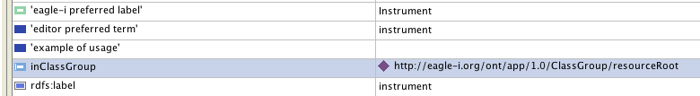

eagle-i ontology
Layered model
BFO, IAO, RO
imports
eagle-i core ontology
imports
eagle-i application ontology
MIREOTed Terms
c o n s o r t i u m

Slide 7
eagle-i ontology
ERO classes: 1059
ERO datatype properties: 56
ERO object properties: 59
MIREOTed classes
c o n s o r t i u m
Notes:
OBI class count =507
OBI properties count =12
SWO class count =53
NCBI class count =182
OCRE class count =19
GO class count =1
UBERON class count =2
VIVO class count =20
BRO class count =13

Slide 8
eagle-i and OBI
MIREOTed classes:
Planned process branch
Roles
Contribution to
Device
Service
Reagent
c o n s o r t i u m
Notes:
Organism, organization

Slide 9
eagle-i and OBI: devices
We have defined about 100 devices in OBI trough QTT
set of functions and equivalent classes
MIREOT these classes back under eagle-i “instrument”
Future plan:
Add additional functions to have a better representation of instrument hierarchy
Add additional defined classes
c o n s o r t i u m

Slide 10
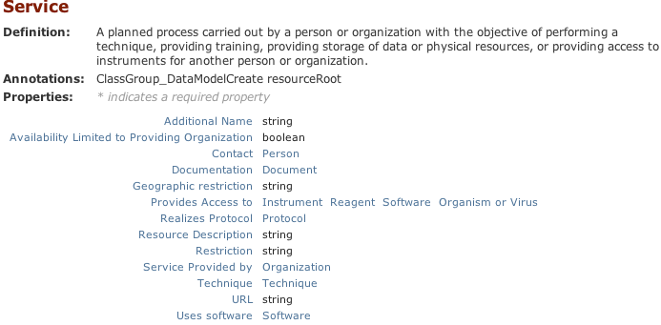
eagle-i and OBI: service
Started discussion in Vancouver Workshop
eagle-i has collected about 2500 services
To be discussed
design pattern, classification hierarchy, shortcut relations
c o n s o r t i u m

Slide 11
eagle-i and OBI: reagents
Reagents are one of ten “Root Resources” inventoried by eagle-i
Reagents not adequately modeled in existing ontologies
Goals :
define ‘reagent’
set a design pattern for modeling
classify reagent types
merging/alignment with OBI
where will reagents live?

